Slide 1
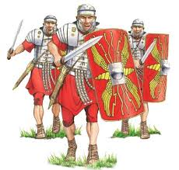
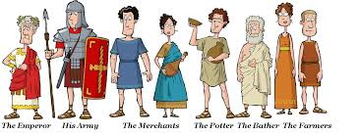
Romans | Year 3/4 | Autumn
Important Questions
1 | Where did the Romans come from, why did they come to England?
2 | Why was the Roman army so powerful?
3. | Who was Julius Caesar? What was he famous for?
4. | Why was Hadrian’s wall built?
5. | Why did Roman rule end in Britain?
6. | Who was Boudicca and what was she famous for?
7. | What did the Romans leave behind?
Key Knowledge
We know about the Romans because we can look at things from their time that still exist today.
I know that the Romans built an Empire.
I know who Boudicca was and why she rebelled against the Romans.
I know who the Emperor Hadrian was. I can say when, how and why he built a wall and explain the features of the wall
I know some of the religious beliefs the Romans had and some of their Gods and Goddesses.
Vocabulary
Empire | A group of countries ruled over by a single monarch.
Forum | The area of a Roman town that was the centre of Roman life.
Emperor | The leader of an empire.
Gladiator | A person who fought for the entertainment of Roman audiences.
Mosaic | A type of art using small tiles of glass or stones to create a picture.
Toga | A long robe worn by Roman citizens.
Timeline
753 BC The building of Rome begins. | 202 BC Rome conquers territories outside Italy. | 43AD The Roman army lands in England. | 61 AD Boudicca rebels against the Romans. | 122 AD The building of Hadrian’s wall begins. | 410AD Roman rule in Britain ends.

