Slide 1
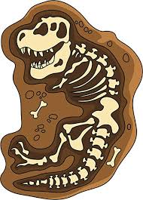
| Rocks Year 3/4 (Science) |
Important Questions
1 | What are the three different types of rocks?
2 | What are the four different types of matter that soil is composed of?
3 | What is a fossil and how is it formed?
4 | How is soil formed?
5 | Who was Mary Anning and why is she famous?
Key Knowledge
1 | To be able to name the three different types of rocks.
2 | To be able to state the four different types of matter that soil is composed of.
3 | To know the difference between a bone and a fossil.
4 | To know how soil is formed.
5 | To know Mary Anning’s contribution to palaeontology
Key Vocabulary
1 | Igneous | Igneous rock is formed when magma cools and becomes solid.
2 | Sedimentary | Sedimentary rocks are formed by sediment that is deposited over time usually at the bottom of lakes and oceans.
3 | Metamorphic | Metamorphic rocks have been changed over time by extreme pressure and heat.
4 | Formation | How something is made or created.
5 | Palaeontology | Palaeontology is the study of fossils to learn about forms of life.
6 | Fossil | The remains of ancient plants and animals.
7 | Magma | Magma is the hot liquid rock under the surface of the earth. It is called lava after it comes out of a volcano.
Key Skills
1 | To be able to compare different types of rocks by appearance
2 | To be able to make systematic and careful observations
3 | To be able to identify and classify different rocks.
4 | To be able to set up a simple investigation (eg. to investigate the permeability of different soil types.)
5 | To be able to present findings scientifically

